Slide 1
Density-Based Clustering
DBSCAN
Nikhil Shegokar | 233 | D3 | AIML5

Slide 2
Introduction

Slide 3
Introduction
DBSCAN (Density-based spatial clustering of applications with noise) is one of the most popular Machine Learning algorithms for clustering in data mining. One of the prime advantages of DBSCAN is that it’s ability to work with data with significant noise and outliers.
DBSCAN does not need to know how many clusters there are in the data set, unlike K-Means clustering.

Slide 4
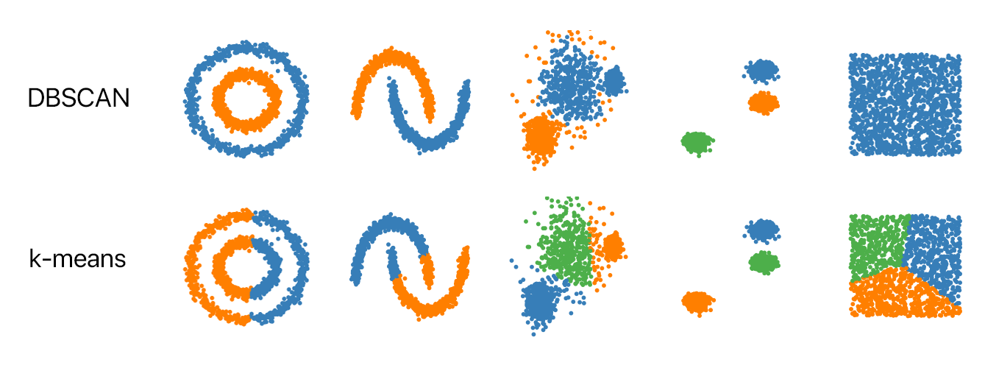
Introduction
DBSCAN is an unsupervised learning algorithm, ie. it needs no training data, it performs the computation on the actual dataset.

Slide 5
Pseudocode
We select a random data point.
Then it will take two arguments to check the density around that point. First, it will make a radius around that point and second, it will check the minimum point in that radius.
If the point checks truly with minimum points then it will make the cluster of that point and move forward to other points and if not then it will treat it as an outlier.
The DBSCAN methods have two parameters of these i.e. eps(epsilon) to make a radius and min_samples to check minimum points.

Slide 6
Implementation

Slide 7
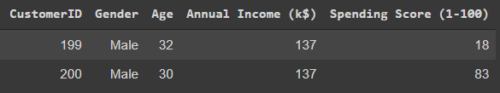
Dataset
The dataset selected is the ‘mall customer segmentation data’ dataset

Slide 8
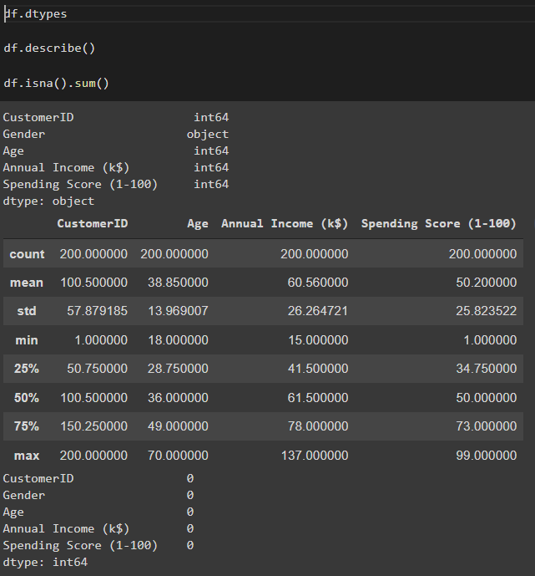
Data Exploration

Slide 9
Steps
Data exploration
Data validation
Checking for outliers
Data visualization
Data cleaning
Data scaling
Clustering

Slide 10
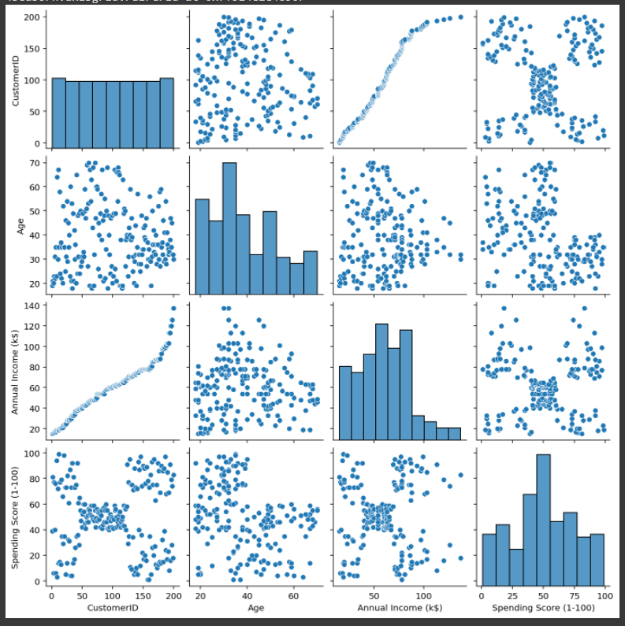

Slide 11
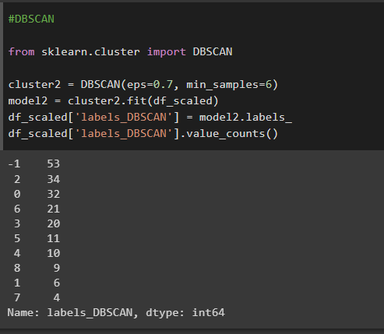
Clustering Model

Slide 12
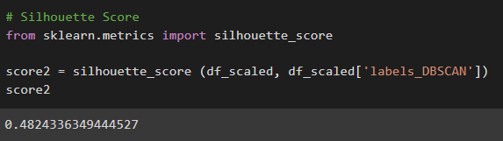
Model Evaluation

Slide 13
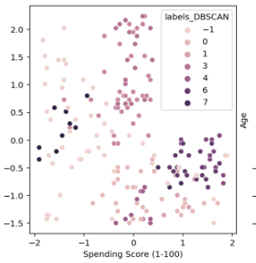
Plotting the final graph

Slide 14
Thank You

